Slide 1
MBC 638
Live Session 2

Slide 2
Agenda for Live Session 2
1. Process Learnings
2. Project
Problem Definition Worksheet feedback
Next steps
3. Kappa example
4. Hank the Handyman
5. Prep for quiz
6. Wrap-up/feedback

Slide 3
Process Learnings
Always use a headset during Live Sessions
Recommended to always use a laptop or desktop – not a Tablet
If you frequently drop out of the Live Sessions, try wired internet
When posting your HW in 2SU, be sure it actually posts. After you Browse, and click on Upload, be sure to click on Submit. If any questions, call 2SU Student Support at 844-797-5622
Be sure to put your name on any Homework
Please, no pdf’s
There is a 10% penalty per day late, up to 4 days late. After that, no credit can be given.
There are passwords for our Quizzes and Final. These will be posted to our Class Wall before each.
Be sure you have access to LaunchPad
Don’t change anything about your process until baseline is gathered in the Measure phase and Analyze is done.

Slide 4
Kappa example- For Measurement System Accuracy
Clinic for youth with mental health challenges
Need to identify which clients are high risk and which are not
Baseline – every clinician doing this their own way
Created operational definitions
Trained the clinicians
Created 10 case studies
Asked each clinician to read each case and determine if youth is high risk or not
Compared results – reproducibility
10 out of 10 clinicians agreed on 8 of the case studies!
Implemented operational definitions (measurement system)

Slide 5
Project – Problem Definition Worksheet Feedback
Be sure not to state solutions or your objective/goal in the problem statement. State the problem.
Never state solutions or root causes anywhere on a Problem Definition Worksheet. You are in the Define phase.
Always aim for quantification in $. You will need to make assumptions. You can include a range.
Scope and Process map should be of the process you are going to improve (think of Hank’s process), not of the actions you will take on your project.
Process map should be of the Current State process you will be working on, not the Future State. Remember we are in the Define phase.
* Overall very good projects were identified!

Slide 6
Projects – Next Steps
What phase should we all be entering?
What is the work of that phase?

Slide 7
DMAIC
Define
Measure
Description:
Clearly identify the business problem / performance gap (output measure), customer, scope, goals and resources.
Key Concepts:
y = f(x)
Types of data
Descriptive statistics and soft tools
Project:
Complete Problem Definition Worksheet
Tools:
Process map
SIPOC
Descriptive statistics
Thought process map
Affinity diagram
Sigma Quality Level (SQL)
Description:
Validate your measurement system and collect baseline data.
Key Concepts:
Mapping a process/value-stream, forms of waste, measurement error, reproducibility, repeatability
Project:
Identify potential inputs, develop operational definitions, develop data measurement/collection plan, validate measurement system, collect baseline data, calculate SQL.
Tools:
Operational definitions
Kappa
Process map (detailed)
Data measurement plan
Data stratification tree
Histogram
Trend/ line chart
Pareto chart
Fishbone (cause/effect) diagram
Week 1
Week 2

Slide 8
Data Measurement Plan
Data Source and Location
How Will Data Be Collected
Who Will Collect
Data
When Will Data Be Collected
Target
Sample
Size
Performance Measure
Develop rating scale & assess performance
5/12
% of orders per Sales Rep by skill level type
average & range of Sales Rep skill levels
Susie
Susie
N/A
% type of call
Manual data collection
Use data collection form
All
5/11-6/2
1000 calls
no. of hours of training per month
John’s training spreadsheet
Manual data collection
John
5/20
12 mo
Example
total orders placed by month
% new orders are of total orders
% order revenue of total revenue by month
IB performance reports
Pull from report
Leanne
By 6/3
28 mo
customer attitude rating by order type
Manual data collection
Use data collection form
All
5/11 - 6/2
500 orders
Average call duration for new order vs. other
Manual data collection
Use data collection form
All
5/11 - 6/2
500 orders
wait time for each call
Obtain from other team
Aspect reports
Leanne
tbd
tbd
% of calls transferred to OB due to pricing issues
Manual data collection
Use data collection form
All
5/11 - 6/2
1000 calls
mystery call /silent monitoring results (points per call)
Monthly mystery call results
Compile Pamela’s data
Leanne
By 6/3
30
% of orders resulting in backorders
Manual data collection
Use data collection form
All
5/11 - 6/2
500 orders
calls, orders, total rev, per Sales Rep per month
IB performance reports
Pull from report
Susie
By 6/3
28 mo
No. of inbound calls per day
IB performance reports
Pull from report
Susie
By 6/3
28 mo
order revenue per Sales Rep per month
IB performance reports
Pull from report
Susie
By 6/3
28mo
Total revenue per month
IB performance reports
Pull from report
Susie
By 6/3
28 mo
Revenue per month by product type
SN report
Pull from report
Leanne
By 6/3
ytd

Slide 9
Data Stratification Tree
Questions About Process
Stratification factors
X Variables
Measurements
Are orders impacted by the sales rep skill-levels (systems, product, pricing, listening, ability to follow the process)?
Skill level
% of orders per Sales Rep by skill level type
average & range of Sales Rep skill levels
What % of the calls are order related?
Type of call
% type of call
Does the Sales Rep have the right skills to improve selling more orders?
Training
no. of hours of training per month
total orders placed by month
% new orders are of total orders
% new order revenue of total revenue by month
Do new orders vary by month ?
Time of year (mo.)
Do new orders change by the receptiveness of the customer?
# of New Orders
Customer attitude
Example
(Output Y)
customer attitude rating by order type
Are orders impacted by call duration?
Average call duration for xyz order vs. other orders
Call duration
Are orders impacted by call wait time?
Wait time
wait time for each call
Are orders impacted by pricing issues?
Pricing Issue
% of calls transferred to OB due to pricing issues
Are orders impacted by whether or not the Sales Rep follows the written process?
Written process
mystery call /silent monitoring results (points per call)
Do new orders vary by the availability of the product (not on backorder)?
No.of backorders
% of orders resulting in backorders
Do the current targets impact orders?
Target settings (calls, orders, revenue)
calls, orders, total rev, rev per mo. per Sales Rep

Slide 10
Hank the Handyman
Objective of the Exercise:
 | Think about a "job" as a process with a flow
 | Create a flowchart of a current process, no evaluating just document what's happening
 | Identify value-add and non value-added steps (this is a form of data collection)
 | Calculate mean and standard deviation of a real process
 | Define a "defect" in a process that is providing a service and not making a widget
 | Calculate SQL for a service-type process
 | Highlight the fact there is more than one "right" answer

Slide 11
Hank the Handyman – discussion questions
How does Hank perceive the problem?
What are Hank’s key metrics?
What are the bottlenecks?
What were some non-value-added steps?
How would you define a defect in Hank’s process?
What processes are broken?

Slide 12
Prep for Quiz 1
In Coursework – Assessments in 2SU
Scope: Week 1 and Week 2 material
Open materials
Taken on your own time
Multiple Choice
10 questions
30 minutes to take. Time yourself. New: System will kick you out at 30 min and will save your work, even if you have not yet hit Save.
Requires a Password – which will be posted to our Class Wall after Live Session 2.

Slide 13
Prep for Quiz 1
What is the formula that describes the relationship of various inputs to the main output?
What is SQL? How do you calculate it?
What is the Lean Six Sigma roadmap? (Hint: it’s an acronym)

Slide 14
Process Mapping and Improvement
Consider each step in the process:
Customer value-add – Would the customer be willing to pay for this? – Streamline
Business value-add – Processes essential to the business, required by regulation or law
- Minimize
Non-value-add: TIMWOOD
- Eliminate

Slide 15
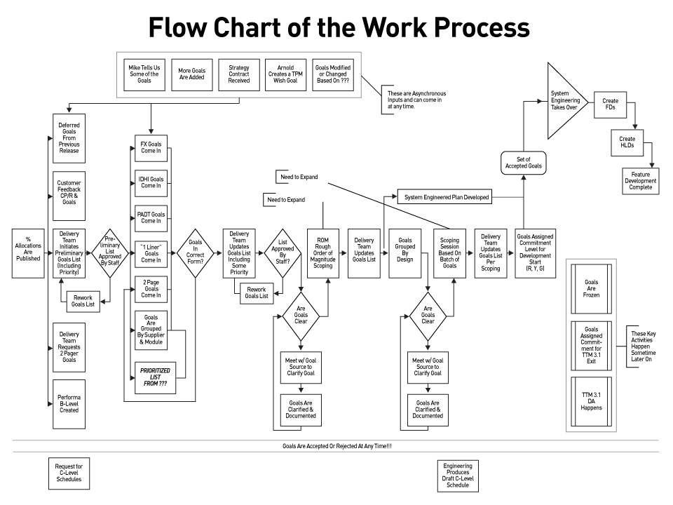
Soft tools
Flow chart/Process Map

Slide 16
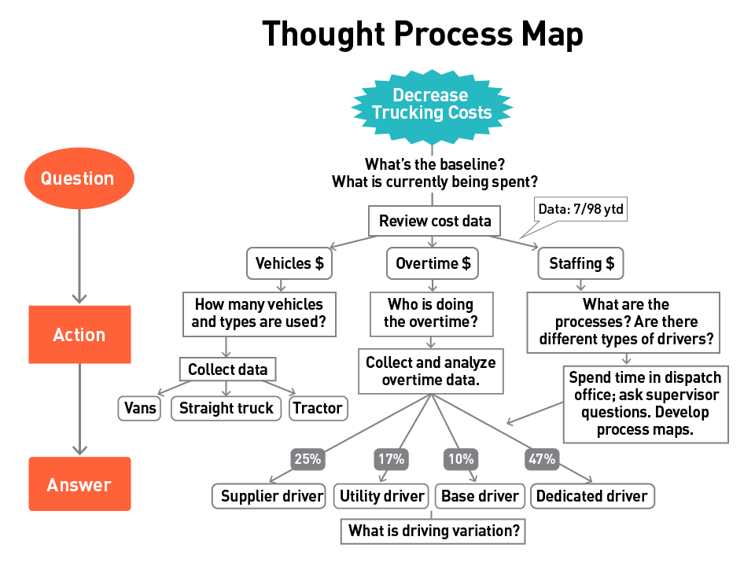
Soft Tools - Continued
Thought Process Map (Question, Action, Answer)

Slide 17
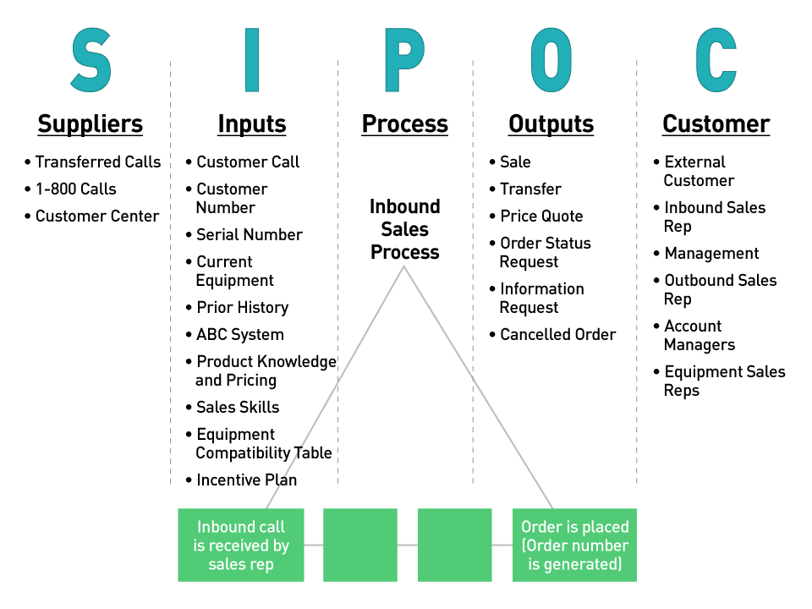
Soft Tools - Continued
SIPOC (Supplier, Inputs, Process, Outputs, Customer)

Slide 18
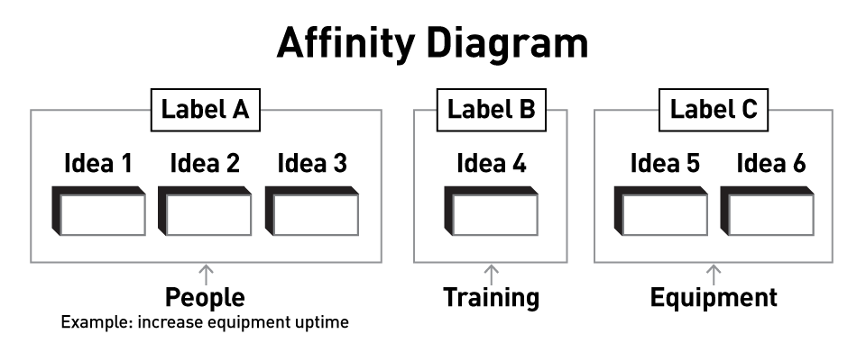
Soft Tools - Continued
Affinity Diagram

Slide 19
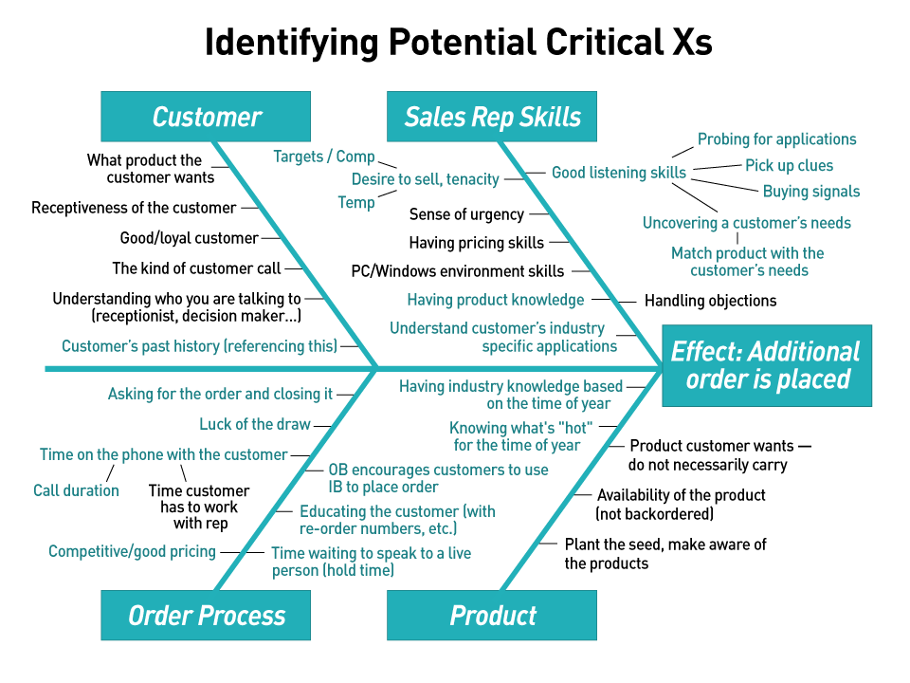
Soft Tools - Continued
Fish Bone – Cause and Effect

Slide 20
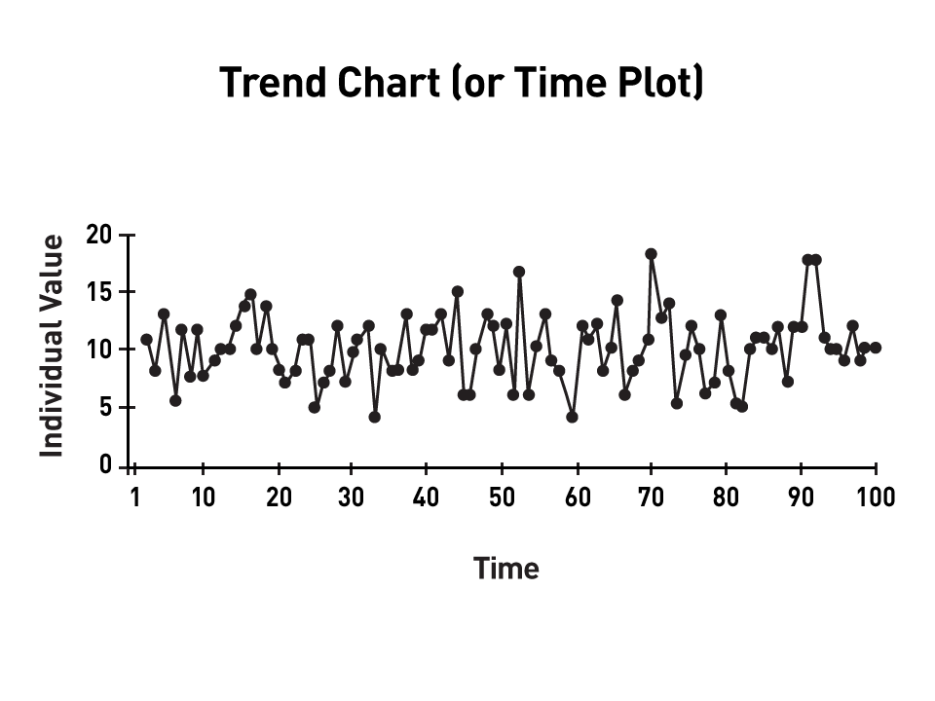
Soft Tools - Continued
Trend Chart
Note performance over a time period

Slide 21
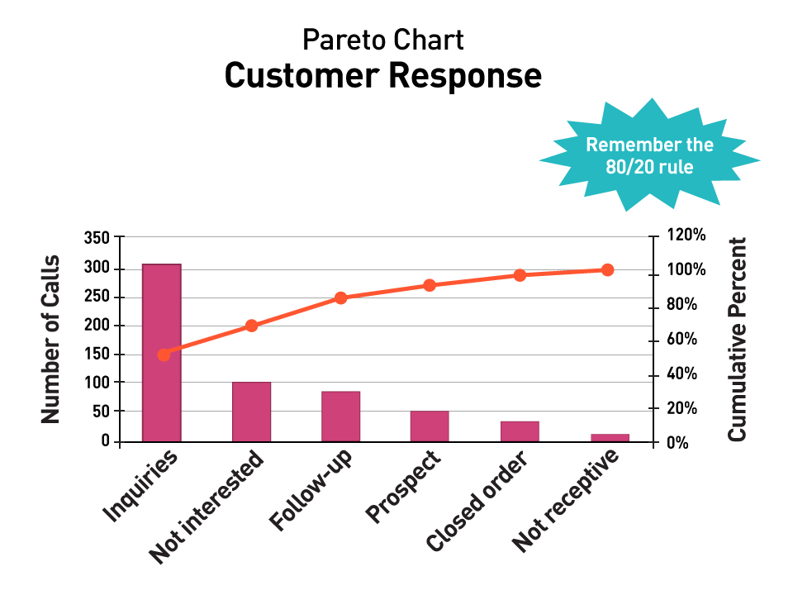
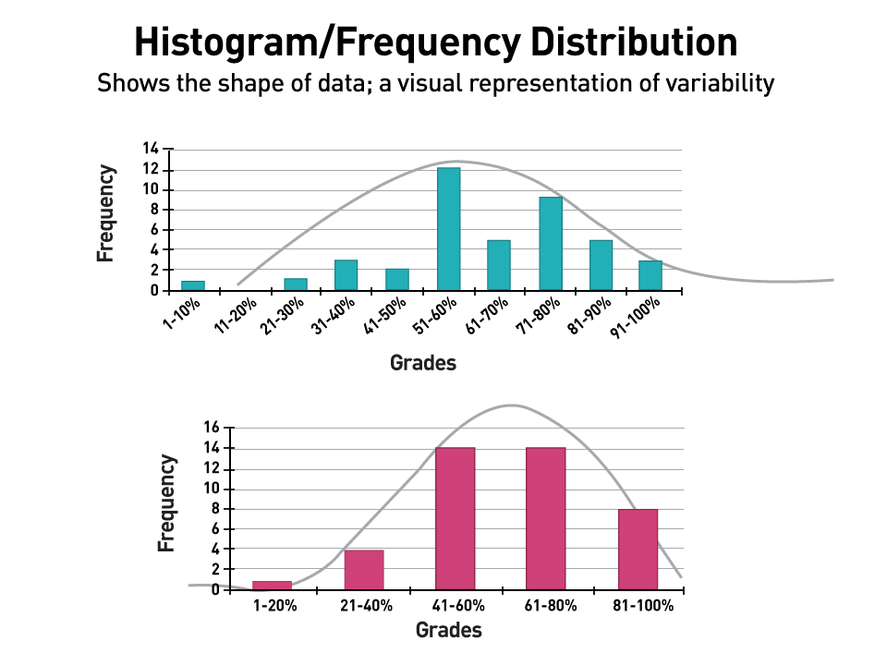
Soft Tools - Continued
Pareto Chart – 80/20
Histogram
Note neither of these is performance
over a time period

Slide 22
Measures of Central Tendency
Mean - The most well-known and widely used measure of center is the mean. In everyday usage, the word average is often used for mean.
Median - In statistics, the median of a data set is the middle data value when the data are put into ascending order. If the sample size n is even, then the median is the mean of the two middle data values.
Mode - A third measure of center is called the mode. In a data set, the mode is the value that occurs the most.

Slide 23
Measures of Spread or Dispersion
Range - The range of a data set is the difference between the largest value and the smallest value in the data set
Standard deviation - The standard deviation quantifies spread with respect to the center and uses all available data values. Standard deviation can roughly be thought of as the sum of the distances between each data value and the mean
Variance – equals standard deviation squared.

Slide 24
Prep for Quiz
Breakouts with topics to explore
When in groups:
Assign note-takers and a presenter
Review your topic. Use your course materials
Prepare to teach the rest of the class a few key points about your topic
You will have about 10-15 min
I will give a few minutes warning and then bring you all back to the overall class.

Slide 25
What’s next:
Note that due dates are included on the Syllabus posted in Files
Class Assignments | Submit / Post Location | Due / Date
Week 2
Quiz #1 | Coursework → Assessments | 3 days after Live Session 2 = Oct 15
Week 3 (Reference: textbook Ch.6 - skip sect. 6.3, Ch.7 - sect. 7.1 only)
Homework #1: (worth 5 points) LaunchPad Assignments Complete LearningCurve for Chapter 3. Complete StatTutor (3 topics): Chapter 6 – Normal Distributions - The Standard Normal Distribution - Using the Standard Normal Table | LaunchPad | 3 days after Live Session 3 = Oct 22

Slide 26
Questions?

